Slide 1
Energy - Chapter 11

Slide 2
Objectives and Vocabulary
Objectives:
Vocabulary:
Compare units of heat measurement
Describe the relationship between molecular motion and temperature
Compare processes of heat transfer
Explain what affects rates of chemical reaction in food
Analyze the relationship between food intake and body weight
Absolute zero
Anorexia nervosa
Bulimia
Calorie
Conduction
Convection
Energy
Heat
Joule
Kilocalorie
Microwaves
Obesity
Radiation
Specific heat

Slide 3
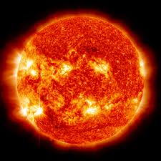
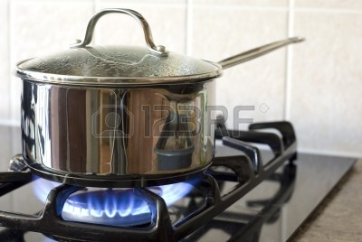
Energy on Earth
The source of physical energy and life on Earth is the sun
It’s absorbed by plants, stored, transferred to anything that eats the plant, then converted to energy of motion
Energy is involved in physical and chemical changes
Ex: boiling water and burning a campfire
Heat – energy transferred from an object of higher temperature to one of lower temperature

Slide 4
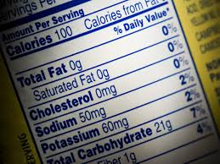
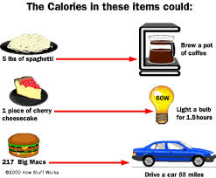
Measuring Heat Energy
Calorie – a unit of heat measurement
1 calorie - the amount of energy needed to raise the temperature of 1.0 gram of water 1.0̊ C
1 kilocalorie – 1,000 calories
Joule – another unit of heat energy used by chemists
1 joule = 0.239 calorie
1 calorie = 4.18 joules
1 kilocalorie = 4.18 kilojoules

Slide 5
Heat Energy and Matter
Molecular motion
Gas - molecules travel at high speeds in a straight line until they hit something, then they bounce off into another direction
Liquid - molecules are closer together, but can tumble past each other allowing liquid to flow
Solid - molecules are locked in place
Absolute zero (-273 degrees C) - all molecular motion stops, and no heat energy remains
Specific heat - the amount of heat needed to raise the temperature of one gram of a substance one degree Celsius

Slide 7
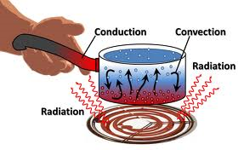
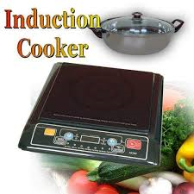
Methods of Heat Transfer
Conduction - heat energy is passed by the collision of molecules
Molecules from the warmer substance transfer until the two substances are the same temperature
Example: pancakes – heat is transferred from the pan to the batter, which cooks it
Convection - heat transfers through circulatory movement in a liquid or gas
Convection current – the circular flow in a liquid that heats it
Radiation - heat transferred as infrared rays
Microwaves
Example: bread in toaster, steak on the grill
Induction – an alternating electric current from a coil heats food

Slide 8
Rates of Reaction
Factors:
How much energy the food absorbs
How quickly energy is absorbed
The rate at which energy is transmitted
Temperature – higher temperatures raise the speed of chemical reactions
The rate of reaction doubles for every 10 degrees C increase
Surface area – increased surface area raises the reaction speed
Heating media
Common media for transferring heat: air, water, steam, and fat

Slide 9
Review Video Complete Worksheet

Slide 10
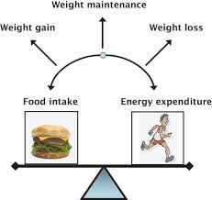
Energy Needs and Health
Obesity- having a body weight that is 20 percent or more above a healthy range
Obesity is also linked to some types of cancer
Energy balance
You should consume roughly the same number of kilocalories as you use in your daily activities
3500 kilocalories= 500 grams of body fat

Slide 11
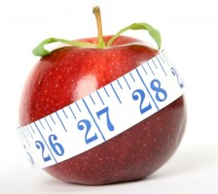
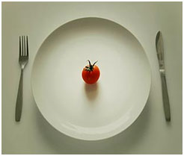
Eating Disorders
Women ages between 12 and 25 are especially prone to eating disorders
Anorexia nervosa - eating disorder characterized by self-starvation
Anorexia is fueled by the belief that one is never thin enough, when in reality that person is dangerously thin and deriving their body of vital nutrients
Bulimia - cycles of binging on large amounts of food followed by self induced vomiting
Bulimia is a vicious cycle of eating to cope with difficult emotions (stress, depression, etc) and then purging out of anger

